Slide 1
SOFT SKILLS EMPLOYABILITY SKILLS PROFESSIONALISM
C.RAGHAVA RAO

Slide 2
SKILLS
Soft Skills Hard Skills
Communicational Skills Technical Skills
Presentation Skills Subject Sills
Managing Skills
Personality

Slide 3
soft skill are`people skills` or `emotional intelligence`.
Soft skills are personal attributes that enhance an individual's interactions, job performance and career prospects.
soft skills relate to a person's ability to interact effectively
Soft Skills are behavioral competencies.
Also known as Interpersonal Skills, or people skills

Slide 4
SOFT SKILLS
Self-awareness
Analytical thinking
Leadership skills
Team-building skills
Flexibility
Ability to communicate effectively
Creativity
Problem-solving skills
Listening skills
Diplomacy
Change-readiness

Slide 5
SOFT SKILLS-HARD SKILLS
Hard skills are the technical abilities required to do a job or perform a task
soft skills are interpersonal skills, written or verbal communication skills and the ability to work under pressure
Hard Skills(Technical Skills) will get you an interview but you need soft skills to get and keep job
Many people often refer to `soft skills` as `people skills` or `emotional intelligence`.

Slide 6
SS THAT ARE GOOD TO HAVE
SS EVERY INDIVIDUAL SHOULD HAVE
SOFT SKILLS

Slide 7
60 "soft skills",
1Math. 2.Safety. 3.Courtesy. 4.Honesty. 5.Grammar. 6.Reliability. 7.Flexibility. 8.Teamskills. 9.Eyecontact. 10.Cooperation | 11.Adaptability. 12.Followrules. 13.Self-directed. 14Good attitude. 15.Writing skills. 16.Driver's license. 17.Dependability. 18.Advanced math. 19.Self-supervising. 20.Good references.
21.Being drug free. 22.Good attendance. 23.Personalenergy. 24.Work experience. 25.Ability to measure. 26.Personal integrity. 27.Good work history. 28.Positive work ethic. 29.Interpersonal skills. 30.Motivational skills | 31.Valuing education. 32.Personal chemistry. 33. Willingness to learn. 34. Commonsense. 35. Critical thinking skills. 36. Knowledge of fractions. 37. Reporting to work on time. 38. Use of rulers and calculators. 39. Good personal appearance. 40. Wanting to do a good job.

Slide 8
60 SOFT SKILLS
41. Basic spelling and grammar. 42. Reading and comprehension. 43. Ability to follow regulations. 44. Willingness to be accountable. 45. Ability to fill out a job application 46. Ability to make production quotas. 47. Basic manufacturing skills training. | 54. Ability to listen and document what you have heard. 55. Commitment to continued training and learning. 56. Willingness to take instruction and responsibility. 57. Ability to relate to coworkers in a close environment.
48. Awareness of how business works. 49. Staying on the job until it is finished. 50. Ability to read and follow instruction 51. Willingness to work second and third shifts. 52. Caring about seeing the company succeed. 53. Understanding what the world is all about. | 58. Not expecting to become a supervisor in the first six months. 59. Willingness to be a good worker and go beyond the traditional eight-hour day. 60. Communication skills with public, fellow employees, supervisors, and customers.

Slide 9
How many soft skills do you possess?

Slide 10
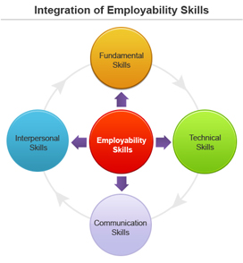
Employability Skills – Skills Needed for a Job

Slide 11
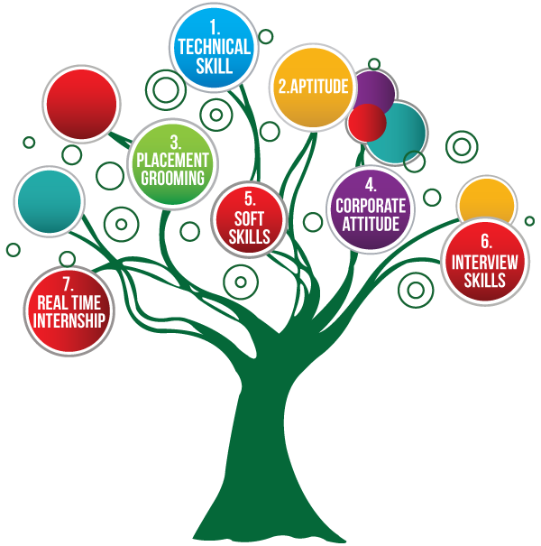

Slide 12
What are Employability Skills?
Employability skills are those skills necessary for getting, keeping and being successful in a job.
They are the skills and attitudes that enable employees
to get along with their colleagues,
to make critical decisions,
solve problems,
develop respect
and ultimately become strong ambassadors for the organisation

Slide 13
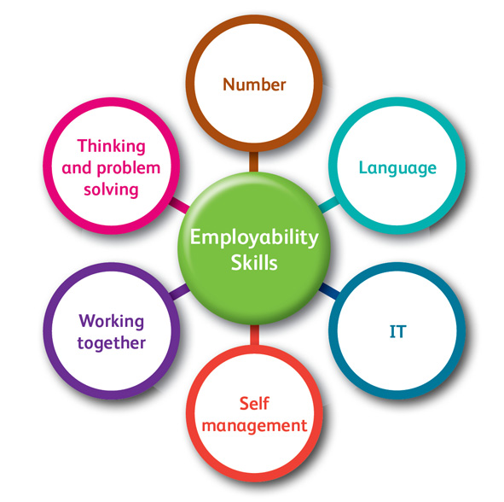

Slide 14

PROFESSIONALISM STUDENTS
Conduct themselves in a mature, professional, and civil manner work with diverse faculty and peers regardless of their race, gender, religion, sexual orientation, or national origin
Exercise the highest integrity in taking examinations, in collecting, analyzing, and presenting research data, and in teaching practice

Slide 15

AIM
More refined and diverse interpersonal skills, particularly in global collaborations,
The ability to live and work comfortably in the transnational engineering environment.

Slide 16

PROFESSIONAL BEHAVIOUR
Professional behavior is what you expect to find in work or social situations. You expect proper language, good manners, a quiet voice. You expect proper dress and politeness. It is basically our best behavior.

Slide 17

PROFESSIONAL APROACH
Where am I now? - This involves making an analysis of the current state of your skills, knowledge and management style. Where do I want to be? - Identify your key areas for personal development. How do I get there? - What action do you need to take to bridge the gap and set yourself up to reach your goals?

Slide 18
THANK YOU
OVER 80% OF EMPLOYERS SAY THAT EMPLOYABILITY SKILLS ARE MORE IMPORTANT THAN DEGREE SUBJECT-
Despite our high rate of unemployment, 300,000 jobs go unfilled largely because many of the unemployed lack the skills needed today as a result of technological progress.
Kim Campbell quotes

Slide 19
So,
My dear budding Engineers
Soft Skills along with your Core Subject
Will make you a proud Marketing piece in
the highly competitive Technical field
LEARN SOFT SKILLS

